Slide 1
Physics Course
Games Academy July 2015
Benjamin Nitschke - Delta Engine

Slide 2
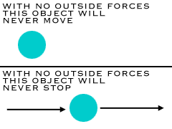
Newtons Laws: First Law
The first law says that an object at rest tends to stay at rest, and an object in motion tends to stay in motion, with the same direction and speed. Motion (or lack of motion) cannot change without an unbalanced force acting. If nothing is happening to you, and nothing does happen, you will never go anywhere. If you're going in a specific direction, unless something happens to you, you will always go in that direction. Forever.
Notes:
Language does not matter, but doing this in C#, Java, Python, etc. is much easier than trying to do this in native C++, but use whatever you are comfortable with.

Slide 3
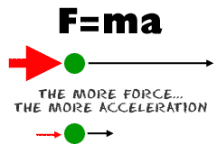
Newtons Laws: Second Law
The second law says that the acceleration of an object produced by a net (total) applied force is directly related to the magnitude of the force, the same direction as the force, and inversely related to the mass of the object (inverse is a value that is one over another number... the inverse of 2 is 1/2). The second law shows that if you exert the same force on two objects of different mass, you will get different accelerations (changes in motion). The effect (acceleration) on the smaller mass will be greater (more noticeable). The effect of a 10 newton force on a baseball would be much greater than that same force acting on a truck.

Slide 4

Newton Laws: Third Law
The third law says that for every action (force) there is an equal and opposite reaction (force). Forces are found in pairs. Think about the time you sit in a chair. Your body exerts a force downward and that chair needs to exert an equal force upward or the chair will collapse. It's an issue of symmetry. Acting forces encounter other forces in the opposite direction. There's also the example of shooting a cannonball. When the cannonball is fired through the air (by the explosion), the cannon is pushed backward. The force pushing the ball out was equal to the force pushing the cannon back, but the effect on the cannon is less noticeable because it has a much larger mass. That example is similar to the kick when a gun fires a bullet forward.
Notes:
http://en.wikipedia.org/wiki/Newton%27s_laws_of_motion
http://www.physics4kids.com/files/motion_laws.html

Slide 5
Time and Distance
By one dimension we mean that the body is moving only in one plane and in a straight line. Like if we roll a marble on a flat table, and if we roll it in a straight line (not easy!), then it would be undergoing one-dimensional motion. There are four variables which put together in an equation can describe this motion. These are Initial Velocity (u); Final Velocity (v), Acceleration (a), Distance Traveled (s) and Time elapsed (t). The equations which tell us the relationship between these variables are as given below.
v = u + at
v 2 = u 2 + 2as Physics Calculator click for calculator
s = ut + 1/2 at 2
Notes:
Language does not matter, but doing this in C#, Java, Python, etc. is much easier than trying to do this in native C++, but use whatever you are comfortable with.

Slide 6
Scalar or Vector?
To explain the difference we use two words: 'magnitude' and 'direction'. By magnitude we mean how much of the quantity is there. By direction we mean is this quantity having a direction which defines it. Physical quantities which are completely specified by just giving out there magnitude are known as scalars. Examples of scalar quantities are distance, mass, speed, volume, density, temperature etc. Other physical quantities cannot be defined by just their magnitude. To define them completely we must also specify their direction. Examples of these are velocity, displacement, acceleration, force, torque, momentum etc.

Slide 7
Momentum
Momentum (p) is the quantity of motion in a body. A heavy body moving at a fast velocity is difficult to stop. A light body at a slow speed, on the other hand can be stopped easily. So momentum has to do with both mass and velocity.
p = mv
Often physics problems deal with momentum before and after a collision. In such cases the total momentum of the bodies before collision is taken as equal to the total momentum of the bodies after collision. Momentum is conserved.
Impulse: This is the change in the momentum of a body caused over a very short time. Let m be the mass and v and u the final and initial velocities of a body.
Impulse = Ft = mv - mu
Notes:
http://tutor4physics.com/formulas.htm
also has calculators to show working formulars

Slide 8
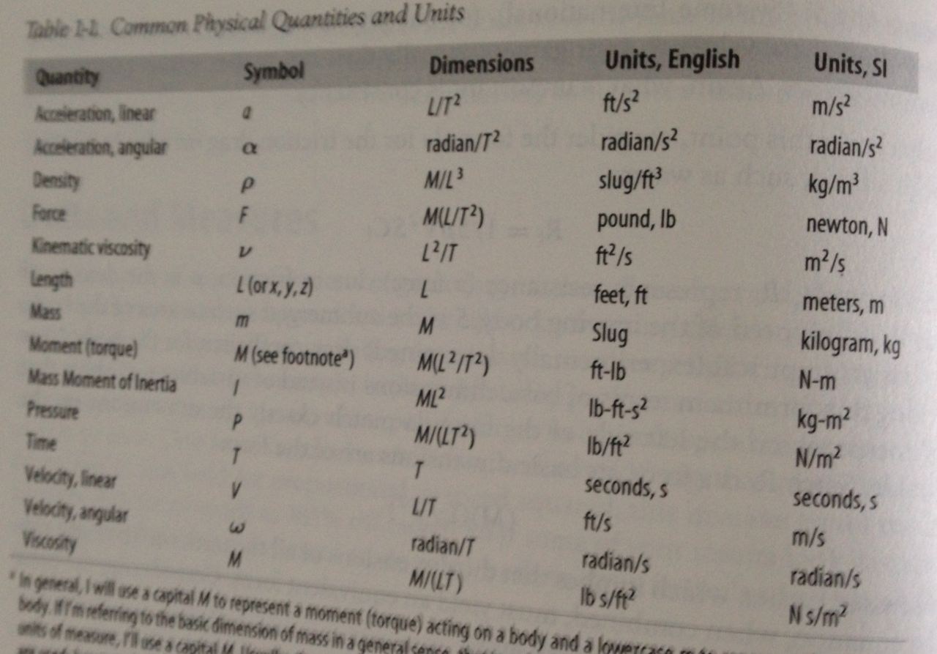
Units
Notes:
https://www.google.de/search?q=2lb+in+kg&ie=utf-8&oe=utf-8&gws_rd=cr,ssl&ei=YNO5VY3SJYHyUsemqTg

Slide 9

2D Physics

Slide 10
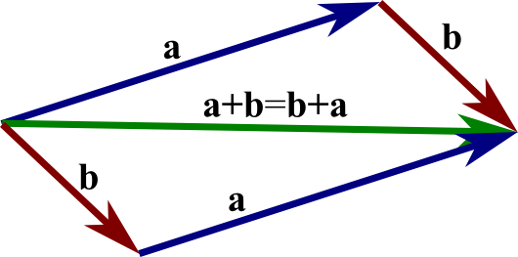
Vector Math
Notes:
Size of Ethernet frame - 24 Bytes
Size of IPv4 Header (without any options) - 20 bytes
Size of TCP Header (without any options) - 20 Bytes
So total size of empty TCP datagram - 24 + 20 + 20 = 64 bytes
Size of UDP header - 8 bytes
So total size of empty UDP datagram - 24 + 20 + 8 = 52 byte

Slide 11
Programming Vector and Matrices
Using C#
For 2D right now, later 3D
Using our GraphicsEngine we got so far
Changing all x/y to Vector2D
Adding Rectangle and Circle Rendering
Using Matrix2D for scaling and rotation

Slide 12
Adding physics
Gravity (global)
PhysicsObject
Mass
Density
Position
Velocity
Acceleration
Torque
Rotation
Notes:
First we all do this manually, next we learn how to use a working physics engine.
Guide to help us along: http://gamedevelopment.tutsplus.com/tutorials/how-to-create-a-custom-2d-physics-engine-the-basics-and-impulse-resolution--gamedev-6331

Slide 13


Using Box2D
For C++ For C#
http://box2d.org/ https://farseerphysics.codeplex.com/
Notes:
http://box2d.org/downloads/
Tutorials and GDC talks
Also see Farseer

Slide 14
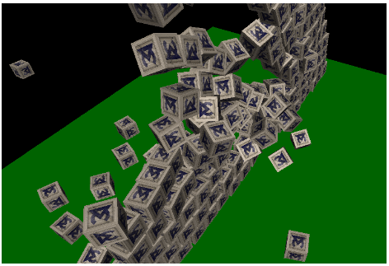
3D Physics

Slide 15

3D Physics: Jitter
Notes:
https://code.google.com/p/jitterphysics/

Slide 16

3D Physics: Bullet
Notes:
http://bulletphysics.org/wordpress/

Slide 17

3D Physics: Havok
Notes:
http://www.havok.com/physics/

Slide 18

3D Physics: Ageia
Notes:
https://en.wikipedia.org/wiki/Ageia
Does not longer exist, was bought by NVidia, now PhysX

Slide 19

3D Physics: PhysX
Notes:
https://developer.nvidia.com/physx-sdk

Slide 20
Getting 3D Up and Running
Using our C# GraphicsEngine
Enabling 3D once again
Render many boxes (no physics)
Using Matrix for everything
transformations
scaling
rotation

Slide 21
Integrating Jitter for 3D Physics
https://code.google.com/p/jitterphysics/
Very nice and fast little library
Predecessor was JigLib
very unorganized, but still useful in the olden days
Let’s integrate it and add more features to our 3D engine
Notes:
https://code.google.com/p/jitterphysics/
http://www.rowlhouse.co.uk/jiglib/

Slide 22
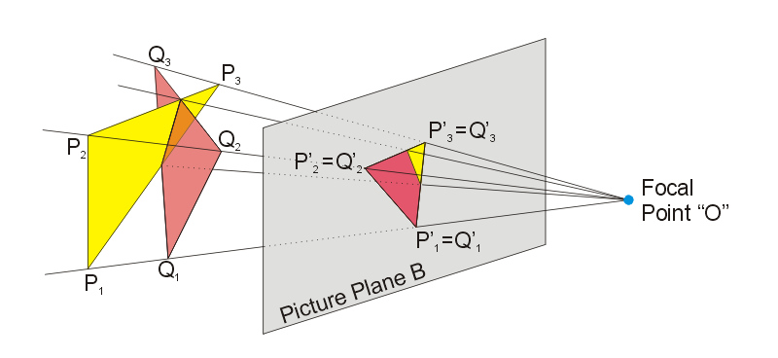
Raycast
3D to 2D can be reversed via Matrix.Invert

Slide 23
PhysX
https://developer.nvidia.com/physx-sdk
Platforms
Win, OSX, Linux, XBOX®, PlayStation®, Android, ioS
Engines
Unreal® Engine 3, Unreal® Engine 4, Unity®
Tools
PhysX Visual Debugger
Maya DCC Plug-In
3D Studio MAX DCC Plug-In
Notes:
https://developer.nvidia.com/physx-sdk

Slide 24
PhysX
Key Features
Rigid Body Simulation
Collision Detection
Character Controller
Particles
Vehicles
Cloth

Slide 25
Questions?
All code and these slides are available at:
https://github.com/BenjaminNitschke/PhysicsCourse

Slide 26
Books
Physics for Game Developers (2003 - classic book, still relevant, by David M. Bourg)
Game Coding Complete - Forth Edition (2013, by Mike McShaffry and David Graham)
Game Programming Gems 1-8 (Physics Chapters)

Slide 27
Physics Development Links
http://box2d.org/
https://farseerphysics.codeplex.com/
https://en.wikipedia.org/wiki/Physics_engine
http://jitter-physics.com/wordpress/
http://bulletphysics.org/wordpress/
http://havok.com/physics
https://developer.nvidia.com/physx-sdk

